Slide 1
Finding the Best City to Move to in The United States
Greg Sullivan
July 02, 2020

Slide 2
Introduction
As a young professional on the job market, I have recently realized the huge discrepancy in housing prices for cities around the United States. Typically, the markets with the higher housing costs are also the markets with the higher salaries. I would like to filter through the data to find which cities I would best be able to buy a house. It is important to note that salary vs. housing cost is not the only factor considered to find the best cities to move to; happiness is probably the most important factor when looking for a place to move.
The goal of this project is to build a notebook that helps the user rank potential places to live. The intended user is anyone who is looking to move to a city within the United States.
Inherently, some very important factors will be left out of this analysis. For example, where family and friends live is not taken into account. The local school system is another major factor not considered in this analysis which many users would consider crucial.

Slide 3
Data
Zillow:
Smoothed, seasonally adjusted measure of the typical home value and market changes
Typical value for homes within the 65th to 95th percentile range
All single-family residences and for all homes with 1, 2, 3, 4 and 5+ bedrooms
Download can be found at https://www.zillow.com/research/data/
U.S. Bureau of Economic Analysis:
Income data is counted per person over 18 years old
Income that people get from wages, proprietors' income, dividends, interest, rents, and government benefits
A person's income is counted in the county, metropolitan statistical area, or other area where they live, even if they work elsewhere.
Download can be found at https://www.bea.gov/data/income-saving/personal-income-county-metro-and-other-areas
Foursquare:
Data is pulled from Foursquare to better understand cities
The number of venues in a city is taken in a 5 mile radius from city center

Slide 4
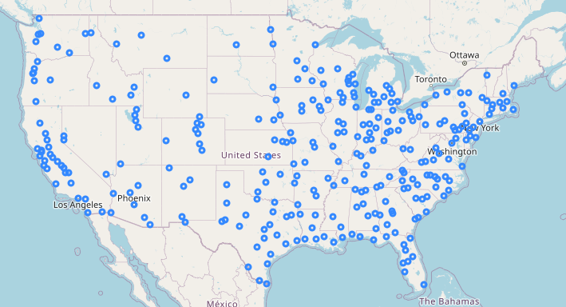
Cities Considered

Slide 5
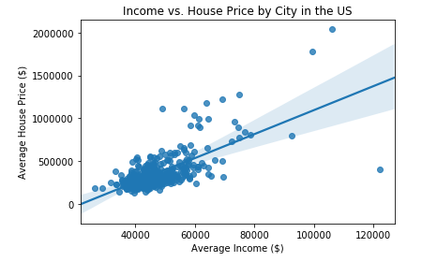
Income vs Housing Price by City

Slide 6
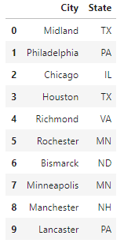
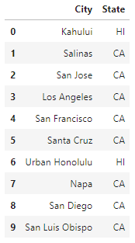
Purchasing Power in Cities
Highest Purchasing Power
Lowest Purchasing Power

Slide 7
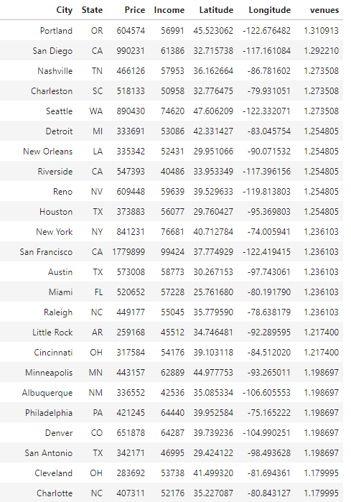
Most Entertaining Cities

Slide 8
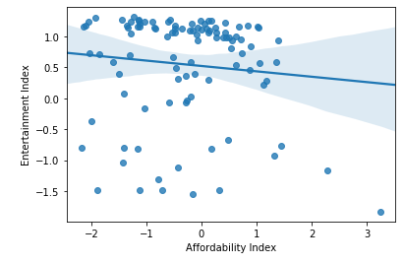
Affordability vs Entertainment by City

Slide 9
And the winner is…

Slide 10
HOUSTON, TX

